Slide 1
DCT Vs FFT for Image Compression
Group members:
Arjun P A - AM.EN.U4AIE20013
Devan Manoj - AM.EN.U4AIE20020
Gokul D Raj - AM.EN.U4AIE20029
Karan R Jayan - AM.EN.U4AIE20040
R.S.Parvati Nair - AM.EN.U4AIE20058

Slide 2

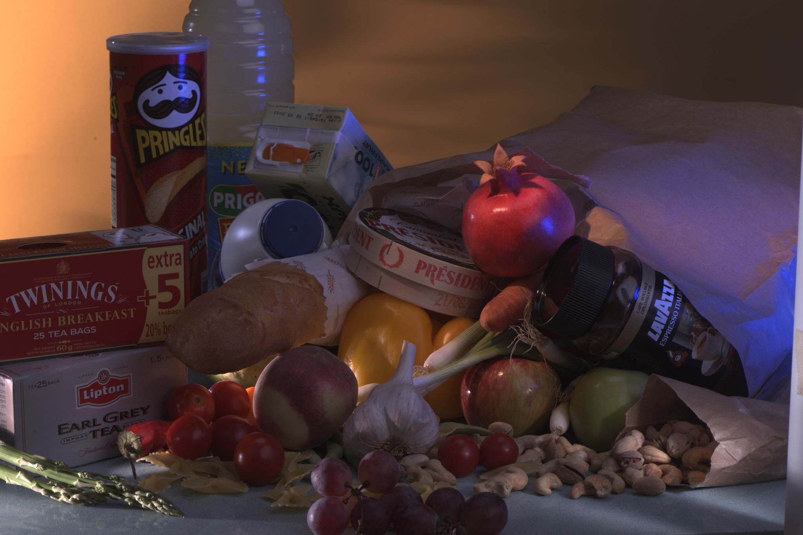
Image Compression
The aim of image compression is to reduce data volume and to achieve a low bit rate in the digital representation of images without perceived loss of image quality.
Here we are comparing and analysing two methods of image compression i.e; DCT and FFT, both which implements Fourier Transform in Matlab; so as to show which is the better method among the two by analyzing them with quality evaluation metrics.
Some sample dataset images used for implementing image compression

Slide 3
Methods Implemented :
Fourier Transform
Fourier transform (FT) is a mathematical transform that decomposes functions depending on space or time into functions depending on spatial or temporal frequency. The term Fourier transform refers to both the frequency domain representation and the mathematical operation that associates the frequency domain representation to a function of space or time.
DCT
The Discrete Cosine Transform (DCT) can be used to convert the signal (spatial information) into numeric data ("frequency" or "spectral" information) so that the image's information exists in a quantitative form that can be manipulated for compression. DCT is a real transform which results in a single real number per data point
FFT
The Fast Fourier Transform (FFT) is an image compression technique where the input image often in a spatial domain is converted to its frequency domain.

Slide 4
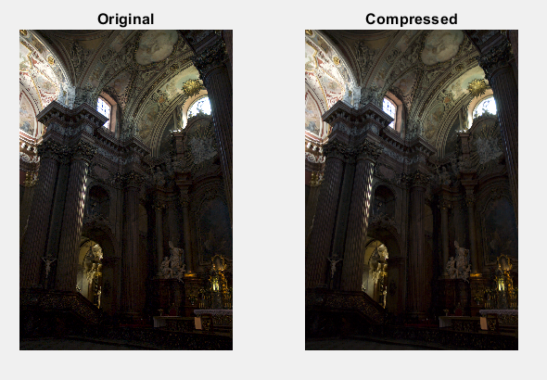
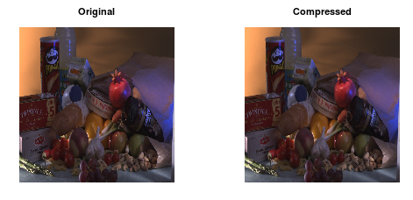
Results And Discussions
The main purpose of this report is to compare the two major image compression techniques, DCT and FFT. To conclude which among the two methods is more efficient. After implementing both these methods for image compression in MATLAB, on the identified dataset, we conclude that DCT is better than FFT. DCT image compression showed better compression ratio while at the same time, maintaining higher image quality over FFT image compression.
.
The code output after implementing DCT and FFT in MATLAB

Slide 5
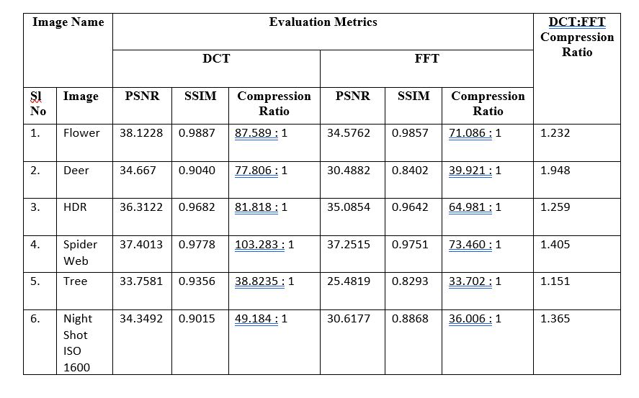
Comparison Table which shows that DCT is better than FFT in both maintaining quality and compression of the image

Slide 6
References
Imdad Ali Ismaili, Sander Ali Khowaja, Waseem Javed Soomro . (n.d.). (rep.). Image Compression, Comparison between Discrete Cosine Transform and Fast Fourier Transform and the problems associated with DCT.
T. Mantoro and F. Alfiah, "Comparison methods of DCT, DWT and FFT techniques approach on lossy image compression," 2017 International Conference on Computing, Engineering, and Design (ICCED), 2017, pp. 1-4, doi: 10.1109/CED.2017.8308126.
Gomathi, S., &amp; Santhanam, T. (n.d.). (tech.). Performance Analysis of Lossless and Lossy Image Compression Techniques for Human Object (Vol. 13, Ser. 15).
Wikimedia Foundation. Fourier transform. Wikipedia.https://en.wikipedia.org/wiki/Fourier_transform.

